Slide 1
Quantitative research methods
Lecture 4: GLM

Slide 2
Course outline
Lecture 1 – Basics of quantitative methods
Philosophical assumptions
Research design
Lab 1 – how to approach a data set
Lecture 2 – Basic concepts for statistics
Samples and populations
Models and hypothesis testing
Lab 2 – testing assumptions and hypotheses
Lecture 3 – towards the general linear model
Correlation
Regression
General linear model
Lab 3 – correlation and regression
Lecture 4 – the general linear model
ANOVA
Factorial ANOVA
Repeated measures ANOVA
Lab 4 - ANOVA

Slide 3
Lecture 4
A fresh example
ANOVA
Why do ANOVA?
GLM - ANOVA as regression
Testing specific effects
Factorial ANOVA
Factorial designs
Interactions
Repeated measures ANOVA
Repeated measures
Mixed designs

Slide 4
Lecture 4
A fresh example
ANOVA
Why do ANOVA?
GLM - ANOVA as regression
Testing specific effects
Factorial ANOVA
Factorial designs
Interactions
Repeated measures ANOVA
Repeated measures
Mixed designs

Slide 5
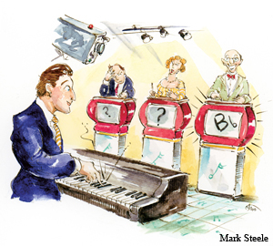
Today’s example
Perception in autism
Higher rate of absolute pitch
Enhanced visual processing of local features
Resistance to illusions
Enhanced visual search

Slide 6

Today’s example
Perception in autism
Higher rate of absolute pitch
Enhanced visual processing of local features
Resistance to illusions
Enhanced visual search

Slide 7

Today’s example
Perception in autism
Higher rate of absolute pitch
Enhanced visual processing of local features
Resistance to illusions
Enhanced visual search

Slide 8
Today’s example
Perception in autism
Higher rate of absolute pitch
Enhanced visual processing of local features
Resistance to illusions
Enhanced visual search

Slide 10
X X X X
X X X X
X X X X
X X X X

Slide 12
X X X X X X X X
X X X X X X X X
X X X X X X X X
X X X X X X X X
X X X X X X X X
X X X X X X X X
X X X X X X X X
X X X X X X X X

Slide 14
X X X X
X S X X
X X X X
X X X X

Slide 16
X X X X X X X X
X X X X X S X X
X X X X X X X X
X X X X X X X X
X X X X X X X X
X X X X X X X X
X X X X X X X X
X X X X X X X X

Slide 18
X S S X
S X X X
X S X S
S X S X

Slide 20
X X X X X X X X
S S X S X S X X
X S X X X X X X
X X X S S S X X
S S X X X X S X
X X X S X X X X
X X X X X S S X
X X S X X X X X

Slide 21
Imaginary experiment – Methods
Subjects
5 typically developed individuals
5 individuals with ASD
5 individuals with ADHD
Stimuli
Previous slide
Design
Independent variable: diagnosis
Dependent variable: search time
Analysis??

Slide 22
Any problems?
Subjects
5 typically developed individuals
5 individuals with ASD
5 individuals with ADHD
Stimuli
Previous slide
Design
Independent variable: diagnosis
Dependent variable: search time
Analysis??
Problems
How do we know the effect is specific to ASD?
Visual search behaviour is related to visual attention
The effect might be general to visual attention disorders, like what is also found in ADHD…
….ASD is often co-morbid with ADHD, and similar drugs are often prescribed
We need to add a new group

Slide 23
Any problems?
Subjects
5 typically developed individuals
5 individuals with ASD
5 individuals with ADHD
Stimuli
Previous slide
Design
Independent variable: diagnosis
Dependent variable: search time
Analysis??
Problems
How do we know the effect is specific to ASD?
Visual search behaviour is related to visual attention
The effect might be general to visual attention disorders, like what is also found in ADHD…
….ASD is often co-morbid with ADHD, and similar drugs are often prescribed
We need to add a new group

Slide 24
Lecture 4
A fresh example
ANOVA
Why do ANOVA?
GLM - ANOVA as regression
Testing specific effects
Factorial ANOVA
Factorial designs
Interactions
Repeated measures ANOVA
Repeated measures
Mixed designs

Slide 25
Hypotheses
ADHDs and ASDs will be faster than TDs
There is a general effect of visual attention disorders
ASDs will be faster than TDs
There is an effect of having autism
ASDs will be faster than ADHDs
The effect of having autism is bigger than the general effect of visual attention disorders

Slide 26
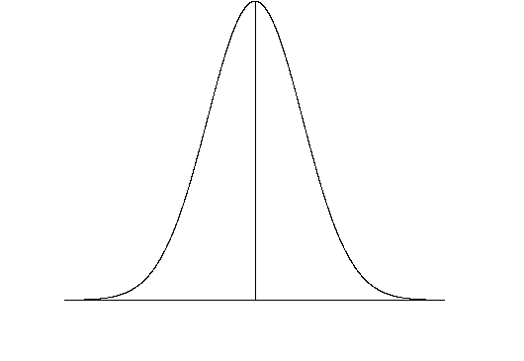
TD
ADHD
ASD
Null hypothesis
Alternative hypotheses

Slide 27
How would we test this?
ASDs will be faster than TDs
There is an effect of having autism
ASDs will be faster than ADHDs
The effect of having autism is bigger than the general effect of visual attention disorders
t tests comparing
ADHDs and TDs
ASDs and TDs
ASDs and ADHDs
What could go wrong with this?

Slide 28
Revision – what do these stats mean?
t statistic
Size of the difference/degree of uncertainty
p value
Probability of getting a t statistics so extreme, given that the null hypothesis is true
Standards for interpretation
p < .05
1 in 20 (i.e. 5/100) t tests will find an effect when there isn’t one

Slide 29


What could go wrong
Adhering to p < .05, for every 100 experiments, 5 will find an effect when there isn’t one
For any t test, there is a 95% chance of correctly rejecting the null
So for 3 t tests, there is a 95% x 95% x 95% = .875% chance of correctly rejecting the null
So for 3 t tests, there is a 100 – 87.5 = 14.3% chance of falsely rejecting the null
3 x p < .05
p = 14.3%
For every 100 experimens, more than 14 will find an effect when there isn’t one

Slide 30
FAMILY WISE ERROR
Adhering to p < .05, for every 100 experiments, 5 will find an effect when there isn’t one
For any t test, there is a 95% chance of correctly rejecting the null
So for 3 t tests, there is a 95% x 95% x 95% = .875% chance of correctly rejecting the null
So for 3 t tests, there is a 100 – 87.5 = 14.3% chance of falsely rejecting the null
3 x p < .05
p = 14.3%
For every 100 experimens, more than 14 will find an effect when there isn’t one
We can address this if we return to the GLM

Slide 31
Lecture 4
A fresh example
ANOVA
Why do ANOVA?
GLM - ANOVA as regression
Testing specific effects
Factorial ANOVA
Factorial designs
Interactions
Repeated measures ANOVA
Repeated measures
Mixed designs

Slide 32


Northward component (km)
Vertical component (km)
1
2
3
4
5
6
1
2
3
4
5
6
Eastward component (km)

Slide 33
Change in y
Vertical Slope =
=1
Northward component (km)
Change in z
Vertical component (km)
1
2
3
4
5
6
Change in y
Eastward Slope =
=4
Change in x
1
2
3
4
5
6
Eastward component (km)

Slide 34
Change in y
Length Slope =
=1
Monthly income
Change in z
Length of education
1
2
3
4
5
6
Change in y
Years after Slope =
=4
Change in x
1
2
3
4
5
6
Years after university
-y-intercept tells us income when years after uni& length of education = 0
-”Years after” Slope tells how much income increases per year after uni
-”Length” Slope tells how much income increases as length of education increases

Slide 35
Change in y
Length Slope =
=1
Monthly income
Change in z
Length of education
1
2
3
4
5
6
Change in y
Years after Slope =
=4
Change in x
1
2
3
4
5
6
Years after university
-y-intercept tells us baseline of outcome
-Slope 1 tells how much outcome changes due to predictor 1 (effect of predictor 1)
-Slope 2 tells how much outcome changes due to predictor 2 (effect of predictor 2)

Slide 36
Linear model
Y_{i} = b₀+b₁X_{i,1}+b₂X_{i,2}+ε_{i}
Model error
Score on independent variable.
Score on
dependent variable for predictor 2
y-intercept:
baseline
slope:
Effect of predictor 2
slope:
Effect of predictor 1
Score on
dependent variable for predictor 1

Slide 37
GLM: From regression to ANOVA
Imagine we have some visual search data…
…but we add diagnosis as a variable
Model: Y_{i} = b₀+b₁X_{i} +ε_{i}…
… how do we model this..

Slide 38
….new information
What do we need to know?
Remember: models are for explanation (and prediction)
Intuitive question: do we improve our explanation by distinguishing diagnoses?
Statistical question: Is a model that also includes the means for the 3 groups, better than a model that only includes the grand mean?
Do we improve the model by adding diagnosis as a variable?
Grand mean

Slide 39
We’ve been treating regression as though everything is interval
Diagnosis is nominal
How do we deal with nominal variables in GLM statistics?
Northward component (km)
Vertical component (km)
1
2
3
4
5
6
1
2
3
4
5
6
Eastward component (km)

Slide 40
Dummy coding
Boolean variable
Indicator variable
Categorical variable
Binary variable
(can only have two values…
….yes or no….
…true or false)
..add dummy code to regression model as a dichotmous dimension…
…but how?
(we can’t just use diagnosis, because it is not dichotomous)
Include ASD as an on/off variable
Include ADHD as an on/off variable

Slide 41

Dummy coding: Boolean expression
TD (controls)
ADHD group
ASD group
ADHD diagnosis
0
1
0
0
0
1
ASD diagnosis

Slide 42
Design matrix (we’ll come back to this)
TD (controls)
ADHD group
ASD group
ADHD diagnosis
0
1
0
0
0
1
ASD diagnosis

Slide 43
Evaluating the model…
Y_{i} = b₀ + b₁X_{i1} + b₂X_{i2} + ε_{i}…
TD (controls)
ADHD group
ASD group
ADHD diagnosis
0
1
0
0
0
1
ASD diagnosis

Slide 44
What’s ε_{i}?
Tells you the difference between your linear model and your real data
Tells you how well your model explains the data
Tells you how well your model fits the data
Error term
Residual

Slide 45
Importance of ε_{i}
Tells you how well your model fits the data
ε_{i} tells you how well data point i follows the model
Adding up the ε’sfor each point tells you how well all the data follows the model
We can’t just add, the signs will cancel
Do the same as for standard deviation
Take the sum of the squared residuals

Slide 46
SS_{M} (model sums of squares)
A measure of how good the model is
But what does good mean?
Good relative to what?
SS_{M}
= combined squared distance of all the data points from the line representing the model Y_{i} = b₀+b₁X_{i} +ε
_{i}= combined error of all the data points considering the influence of the predictor

Slide 47
Linear models can be better or worse fits to the data
The best model is the one with the lowest error term simultaneously for each data point
Line of best fit, regression line, least squared line

Slide 48
So how do we quantify the fit of a linear model???

Slide 49
We ask how much of the total variance (i.e. variability of outcome around its own mean) can be explained by the model

Slide 50
Divided by
SS_{M}
= combined squared distance of all the data points from the line representing the model Y_{i} = b₀+b₁X_{i} +ε
_{i}= combined error of all the data points, considering the influence of the predictor
SS_{T}
= combined squared distance of all the data points from the line representing the mean
= combined error of all the data points not considering the influence of the predictor

Slide 51
Statistic for quantifying the fit of a model
-The line of best fit, regression line, or least squared line is the one with the highest possible R²
-Does this have any relation to the correlation co-efficient r
-Yes, it is r, butsquared

Slide 52
New situation
Not asking about distance of data points from regression line
Grand mean

Slide 53
New situation
Not asking about distance of data points from regression line
Asking about distance of the group means from the grand mean…
….and whether that is a better model of the data than just the grand mean
Grand mean

Slide 54
SS_{M} (Model sums of squares)
A measure of how good the model is
But what does good mean?
Good relative to what?
Grand mean
SS_{M}
= combined squared distance of all the group means from the grand mean
We need a test statistic!

Slide 55
General form of a test statistic
Effect we are measuring
Error related to sampling
How do we define error related to sampling in the GLM?

Slide 56
SS_{R} (Residual sums of squares)
SS_{R}
= combined squared distance of all the data points from the line representing the group mean
= combined error of all the data points, relative to the effects we are interested in
= variance associated with things other than the group differences were are looking
Grand mean

Slide 57
Test statistic for ANOVA
?
Effect we are measuring
Error related to sampling
We need one more step….

Slide 58
Mean squares
SS tells us the combined error for all the data points
If we have lots of data points, we’ll have a large SS
We need to standardise for the number of subjects/measurements
Take the average error…
….divide by the number of subjects….
….but correct for the fact that we already estimated a parameter (i.e. the group mean)….
…(remember degrees of freedom)…
….divide by (n-1)

Slide 59
Mean squares
(Number of groups -1)
(Number of subjects -1)

Slide 60
F-ratio: Test statistic for ANOVA
Effect we are measuring
Error related to sampling
….but how do we know if F is significant?
…do an F test and get a p value

Slide 61
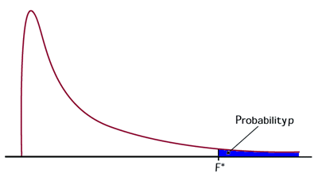
F test
F-distribution: similar to the normal curve
Parameter defining its shape
Parameter defining its scale
Area under curve = probability of 1
We can ask the probability of getting a F-statistic of more than some number
Area under the relevant part of the curve
p = ? (we can look this up in a table)
p-value: keyconcept in statistics
Will come up constantly

Slide 62
What does an F test tell us?
DOES tell us
…if we learn something by distinguish between groups
…if knowledge of group means is more useful than just knowledge of the grand mean
…if there is a significant effect of group
Grand mean

Slide 63
What does an F test tell us?
Does NOT tell us
…if specific groups are significantly different from one another
…if ADHDs and ASDs will be faster than TDs
There is a general effect of visual attention disorders
…if ASDs will be faster than ADHDs
The effect of having autism is bigger than the general effect of visual attention disorders
Grand mean
We can’t test our hypotheses yet!

Slide 64
Lecture 4
A fresh example
ANOVA
Why do ANOVA?
GLM - ANOVA as regression
Testing specific effects
Factorial ANOVA
Factorial designs
Interactions
Repeated measures ANOVA
Repeated measures
Mixed designs

Slide 65
Planned contrasts
The reason
To identify specific (hypothesised) effects without inflating family wise error
The (overall) strategy
If you want more specific effects…
…then do “more specific ANOVAs” (loosely)
Restrict the scope of your new ANOVAs to fewer groups…
…look for significant effects within those narrower scopes
Do this by weighting the groups/variables in your GLM
PLANNED CONTRASTS
Partitioning variance – figures adapted from field

Slide 66
SS_{T}
Total variance in the data
SS_{M}
Variance explained by the model
SS_{R}
Unexplained variance
Initial ANOVA
SS_{Psychopathology}
Variance explained by ASD + ADHD participants
SS_{TD}
Variance explained by typically developed group
Contrast 1:
Effect of attention disorder
Contrast 2:
Effect of ASD
SS_{ASD}
SS_{ADHD}

Slide 67
SS_{T}
Total variance in the data
SS_{M}
Variance explained by the model
SS_{R}
Unexplained variance
Y_{i}=b₀+b₁X_{i1}+b₂X_{i2}
SS_{Psychopathology}
Variance explained by ASD + ADHD participants
SS_{TD}
Variance explained by typically developed group
?
?
SS_{ASD}
SS_{ADHD}

Slide 68
Design matrix
Y_{i} = b₀ + b₁X_{i1} + b₂X_{i2}
TD (controls)
ADHD group
ASD group
ADHD diagnosis
0
1
0
0
0
1
ASD diagnosis

Slide 69
Contrast weights – Contrast 1
2
1
1
Why is the scale balanced? We’ll get to this
Y_{i} = b₀ + b₁X_{i1} + b₂X_{i2}
TD (controls)
ADHD group
ASD group
ADHD diagnosis
0
1
0
0
0
1
ASD diagnosis

Slide 70
SS_{T}
Total variance in the data
SS_{M}
Variance explained by the model
SS_{R}
Unexplained variance
Y_{i}=b₀+b₁X_{i1}+b₂X_{i2}
SS_{Psychopathology}
Variance explained by ASD + ADHD participants
SS_{TD}
Variance explained by typically developed group
Y_{i}= -2 x b₀ + 1 x b₁ + 1 x b₂
?
SS_{ASD}
SS_{ADHD}

Slide 71
Contrast weights – Contrast 2
1
1
Y_{i} = b₀ + b₁X_{i1} + b₂X_{i2}
TD (controls)
ADHD group
ASD group
ADHD diagnosis
0
1
0
0
0
1
ASD diagnosis

Slide 72
SS_{T}
Total variance in the data
SS_{M}
Variance explained by the model
SS_{R}
Unexplained variance
Y_{i}=b₀+b₁X_{i1}+b₂X_{i2}
SS_{Psychopathology}
Variance explained by ASD + ADHD participants
SS_{TD}
Variance explained by typically developed group
Y_{i}= -2 x b₀ + 1 x b₁ + 1 x b₂
Y_{i}= 0 x b₀ + -1 x b₁ + 1 x b₂
SS_{ASD}
SS_{ADHD}

Slide 73
TD (controls)
ADHD group
ASD group
Contrast 1
2
1
1
Contrast 2
1
1
ADHD diagnosis
0
1
0
0
0
1
ASD diagnosis

Slide 74
TD (controls)
ADHD group
ASD group
-2 | 1 | 1
0 | -1 | 1
0 | 1 | 0
0 | 0 | 1
Contrast 1
Contrast Vectors
Contrast 2
ADHD diagnosis
Design Matrix
ASD diagnosis

Slide 75
Orthogonality
Contrasts should be ORTHOGONAL
Each group/condition should only appear ONCE in a contrast
When “partitioning the variance”, each group should only appear in one “partition”
Partitions should be independent
Variance in partitions should not be correlated with one another
Why?
If you follow this, then the weights in your contrast vector will sum to zero

Slide 76
FAMILY WISE ERROR
Adhering to p < .05, for every 100 experiments, 5 will find an effect when there isn’t one
For any t test, there is a 95% chance of correctly rejecting the null
So for 3 t tests, there is a 95% x 95% x 95% = .875% chance of correctly rejecting the null
So for 3 t tests, there is a 100 – 87.5 = 14.3% chance of falsely rejecting the null
3 x p < .05
p = 14.3%
For every 100 experimens, more than 14 will find an effect when there isn’t one
We can address this if we return to the GLM

Slide 77
Orthogonality
Contrasts should be ORTHOGONAL
Each group/condition should only appear ONCE in a contrast
When “partitioning the variance”, each group should only appear in one “partition”
Partitions should be independent
Variance in partitions should not be correlated with one another
Why?
If you follow this, then the weights in your contrast vector will sum to zero

Slide 78
TD (controls)
ADHD group
ASD group
-2 | 1 | 1
0 | -1 | 1
0 | 1 | 0
0 | 0 | 1
Contrast 1
Contrast Vectors
Contrast 2
ADHD diagnosis
Design Matrix
ASD diagnosis

Slide 79
Post-hoc tests

Slide 80
TD
ADHD
ASD
Null hypothesis
Alternative hypotheses

Slide 81
How would we test this?
ASDs will be faster than TDs
There is an effect of having autism
ASDs will be faster than ADHDs
The effect of having autism is bigger than the general effect of visual attention disorders
t tests comparing
ADHDs and TDs
ASDs and TDs
ASDs and ADHDs
What could go wrong with this?

Slide 82
FAMILY WISE ERROR
Adhering to p < .05, for every 100 experiments, 5 will find an effect when there isn’t one
For any t test, there is a 95% chance of correctly rejecting the null
So for 3 t tests, there is a 95% x 95% x 95% = .875% chance of correctly rejecting the null
So for 3 t tests, there is a 100 – 87.5 = 14.3% chance of falsely rejecting the null
3 x p < .05
p = 14.3%
For every 100 experimens, more than 14 will find an effect when there isn’t one
We can also address this if we lower the p-value that we accept as significant – Bonferroni correction

Slide 83
Lecture 4
A fresh example
ANOVA
Why do ANOVA?
GLM - ANOVA as regression
Testing specific effects
Factorial ANOVA
Factorial designs
Interactions
Repeated measures ANOVA
Repeated measures
Mixed designs

Slide 84
Our pretend example
Visual search is enhanced in conditions involving disorders of visual attention
This enhancement is particularly pronounced in ASD
Is this an effect of visual attention functioning?
Is this an effect of medication?

Slide 85
Imaginary follow-up study – Methods
Subjects
5 individuals with ASD on ritalin
5 individuals with ADHD on ritalin
5 individuals with ASD on placebo
5 individuals with ADHD on placebo
Stimuli
Visual search
Design
Independent variable: diagnosis
Independent variable: drug
Dependent variable: search time
Analysis?? – Factorial ANOVA
What sort of questions are we asking?
Let’s partial some variance!
Representing factorial designs
Drug
 | P | R
ASD
ADHD
Diagnosis

Slide 86
Imaginary follow-up study – Methods
Subjects
5 individuals with ASD on ritalin
5 individuals with ADHD on ritalin
5 individuals with ASD on placebo
5 individuals with ADHD on placebo
Stimuli
Visual search
Design
Independent variable: diagnosis
Independent variable: drug
Dependent variable: search time
Analysis?? – Factorial ANOVA
What sort of questions are we asking?
Let’s partial some variance!
Representing factorial designs
Drug
 | P | R
ASD
ADHD
Diagnosis

Slide 87
Questions??
Is there an effect of diagnosis?
Is there an effect of drug?
Is there an effect of drug, on the effect of diagnosis?
Is there an effect of one factor/variable, on the effect of another?
Is there an interaction between variables/factors?
Is there a drug x diagnosis interaction

Slide 88
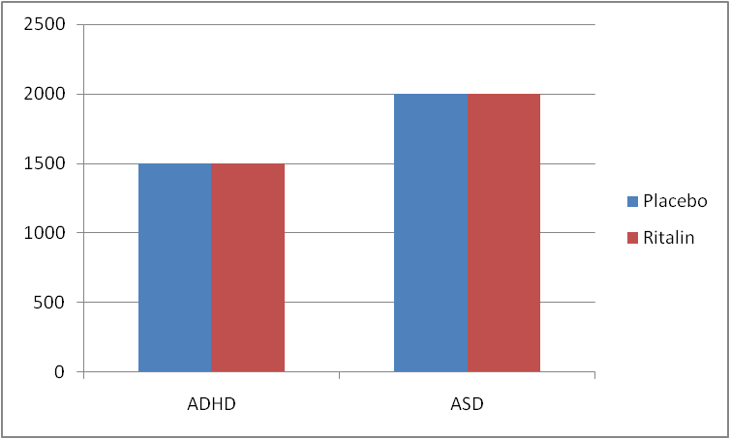
Questions??
Is there an effect of diagnosis?
Is there an effect of drug?
Is there a drug x diagnosis interaction?

Slide 89
Questions??
Is there an effect of diagnosis?
Is there an effect of drug?
Is there a drug x diagnosis interaction?

Slide 90
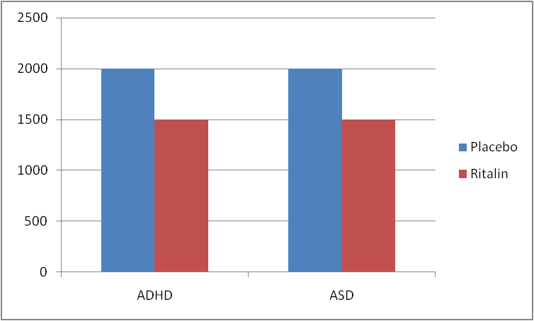
Questions??
Is there an effect of diagnosis?
Is there an effect of drug?
Is there a drug x diagnosis interaction?

Slide 91
Questions??
Is there an effect of diagnosis?
Is there an effect of drug?
Is there a drug x diagnosis interaction?

Slide 92
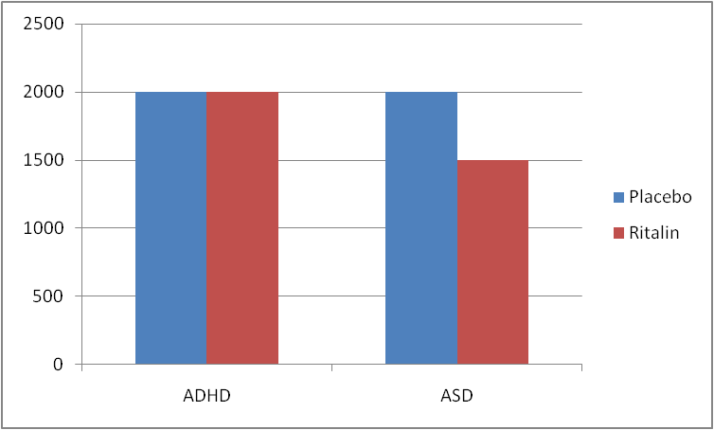
Questions??
Is there an effect of diagnosis?
Is there an effect of drug?
Is there a drug x diagnosis interaction?

Slide 93
Questions??
Is there an effect of diagnosis?
Is there an effect of drug?
Is there a drug x diagnosis interaction?

Slide 94
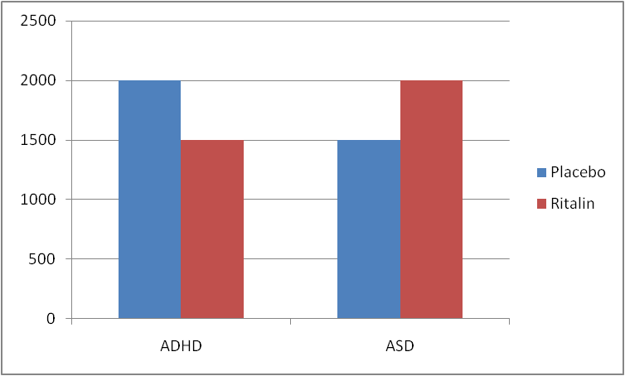
Questions??
Is there an effect of diagnosis?
Is there an effect of drug?
Is there a drug x diagnosis interaction?

Slide 95
Questions??
Is there an effect of diagnosis?
Is there an effect of drug?
Is there a drug x diagnosis interaction?

Slide 96
Imaginary follow-up study – Methods
Subjects
5 individuals with ASD on ritalin
5 individuals with ADHD on ritalin
5 individuals with ASD on placebo
5 individuals with ADHD on placebo
Stimuli
Visual search
Design
Independent variable: diagnosis
Independent variable: drug
Dependent variable: search time
Analysis?? – Factorial ANOVA
What sort of questions are we asking?
Let’s partial some variance!
Representing factorial designs
Drug
 | P | R
ASD
ADHD
Diagnosis

Slide 97
SS_{T}
Total variance in the data
SS_{M}
Variance explained by the model
SS_{R}
Unexplained variance
SS_{Diagnosis}
SS_{Drug}
SS_{Interaction}
Y_{i}= b₀ + b_{diagnosis} + b_{drug} + b_{interaction} + ε_{i}

Slide 98
F-ratio: Test statistic for ANOVA
….but how do we know if F is significant?
…do an F test and get a p value

Slide 99
Factorial ANOVA
Similar approaches to…
Investigate specific effects
Define contrasts
Correct for multiple comparisons
Etc
Additional concerns
Effect sizes
See lab

Slide 100
Lecture 4
A fresh example
ANOVA
Why do ANOVA?
GLM - ANOVA as regression
Testing specific effects
Factorial ANOVA
Factorial designs
Interactions
Repeated measures ANOVA
Repeated measures
Mixed designs

Slide 101
X X X X X X X X
X X X X X X X X
X X X X X X X X
X X X X X X X X
X X X X X X X X
X X X X X X X X
X X X X X X X X
X X X X X X X X

Slide 102
X X X X X X X X
S S X S X S X X
X S X X X X X X
X X X S S S X X
S S X X X X S X
X X X S X X X X
X X X X X S S X
X X S X X X X X

Slide 103
Questions??
Is there an effect of diagnosis?
Is there an effect of search type?
Is there a search type x diagnosis interaction?
Search
 | Feat | Conj
ASD
ADHD
Diagnosis

Slide 104
SS_{T}
Total variance in the data
SS_{B}
Between subjects variance
SS_{W}
Within subjects variance
SS_{Diagnosis}
SS_{R}
SS_{search}
SS_{R}

Slide 105
Repeated measures (mixed) ANOVA
Similar approaches to…
Test hypotheses
Investigate specific effects
Define contrasts
Correct for multiple comparisons
etc
Additional concerns
Sphericity
See lab

Slide 106
Course outline
Lecture 1 – Basics of quantitative methods
Philosophical assumptions
Research design
Lab 1 – how to approach a data set
Lecture 2 – Basic concepts for statistics
Samples and populations
Models and hypothesis testing
Lab 2 – testing assumptions and hypotheses
Lecture 3 – towards the general linear model
Correlation
Regression
General linear model
Lab 3 – correlation and regression
Lecture 4 – the general linear model
ANOVA
Factorial ANOVA
Repeated measures ANOVA
Lab 4 - ANOVA

Slide 107
Wrapping it all up…
Concept
Theory
Construct validity
CRITERION OF SUFFICIENCY
Operational definition
Criterion validity
Dependant variable measured in a sample
Sample
data
External validity
CRITERION OF UNIVERSALITY
Population in real world
Reliability
Population at relevant times
“Reality”

Slide 108
Wrapping it all up…
Concept
Theory
Construct validity
Operational definition
Criterion validity
Dependent variable measured in a sample
Sample
data
External validity
Population in real world
Reliability
Population at relevant times
“Reality”

Slide 109
Wrapping it all up…
Concept
Theory
Statistical model
Operational definition
Dependent variable measured in a sample
Sample
data
Sample
statistic
Population in real world
Hypothesis testing
Population at relevant times
“Reality”
Population statistic

Slide 110
Wrapping it all up…
Theory
Statistical model
GLM
Sample
data
Sample
statistic
Hypothesis testing
“Reality”
Population statistic

Slide 111
Course outline
Lecture 1 – Basics of quantitative methods
Philosophical assumptions
Research design
Lecture 2 – Basic concepts for statistics
Samples and populations
Models and hypothesis testing
Lecture 3 – towards the general linear model
Correlation
Regression
General linear model
Lecture 4 – the general linear model
ANOVA
Factorial ANOVA
Repeated measures ANOVA

